Slide 1
Chapter 11
How to make predictions with a multiple regression model

Slide 2
Objectives
Applied
Use Scikit-learn to create and validate a multiple regression model from the variables that you select and to use the model to make predictions.
Find and review the categorical columns in a DataFrame.
Create dummy variables for the categorical columns in a DataFrame.
Use Scikit-learn to rescale the data in a DataFrame that includes dummy variables.
Use the feature selector of Scikit-learn to select the independent variables for a multiple regression model.

Slide 3
Objectives (continued)
Knowledge
Identify the three types of categorical variables.
Describe the process of rescaling data that includes dummy variables.
Describe the process of selecting the right variables for a multiple regression model as well as the right number of variables.
Interpret feature selection charts.

Slide 4
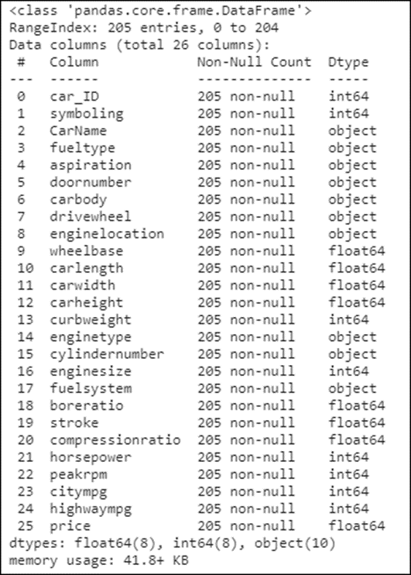
The columns of the Cars dataset
carsData.info()

Slide 5
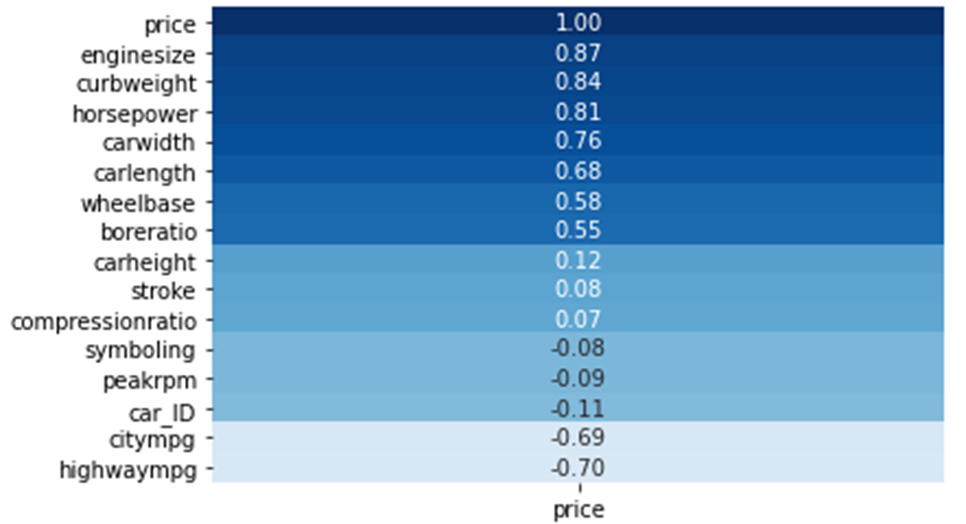
A heatmap for the correlations with price
sns.heatmap(data=carsData.corr()[['price']].sort_values('price',
ascending=False), annot=True, cmap='Blues', vmin=-1.0, vmax=1.0,
cbar=False, fmt='.2f')

Slide 6
How to create a linear regression model
Import the LinearRegression class and the train_ test_split() function
from sklearn.linear_model import LinearRegression
from sklearn.model_selection import train_test_split
Step 1: Split the data into the training and test datasets
x_train, x_test, y_train, y_test = \
train_test_split(carsData[['enginesize']],
carsData[['price']], test_size=0.20, random_state=20)
Step 2: Create the model from the training dataset
model = LinearRegression()
model.fit(x_train, y_train)
Step 3: Score the model with the test dataset
model.score(x_test, y_test)
===========================
0.7063964117029844

Slide 7
How to create a linear regression model (cont.)
Step 4: Score the model with the training dataset
model.score(x_train, y_train)
=============================
0.766524123801206

Slide 8
How to use the simple regression model to make predictions for the test dataset
y_predicted = model.predict(x_test)

Slide 9
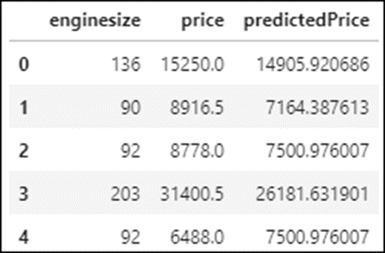
How to create a DataFrame for the predicted and actual prices (simple regression)
Create the DataFrame for the price predictions
predicted = pd.DataFrame(y_predicted, columns=['predictedPrice'])
Combine the test data and the predicted data into a DataFrame
final = predicted.join([x_test.reset_index(drop=True),
y_test.reset_index(drop=True)])
final[['enginesize','price','predictedPrice']].head()

Slide 10
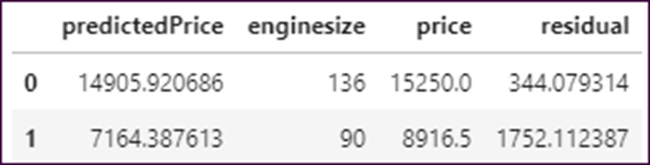
How to calculate the residuals for a simple regression
final['residual'] = final.price - final.predictedPrice
final.head(2)

Slide 11
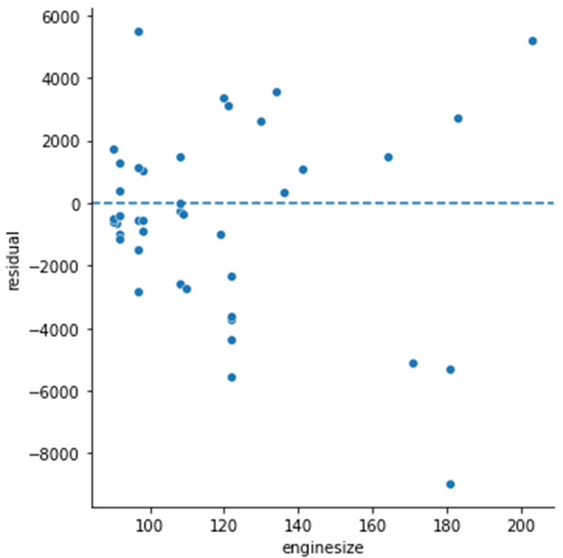
How to plot the residuals with a scatterplot
g = sns.relplot(data=final, x='enginesize', y='residual')
for ax in g.axes.flat:
ax.axhline(0, ls='--')

Slide 12
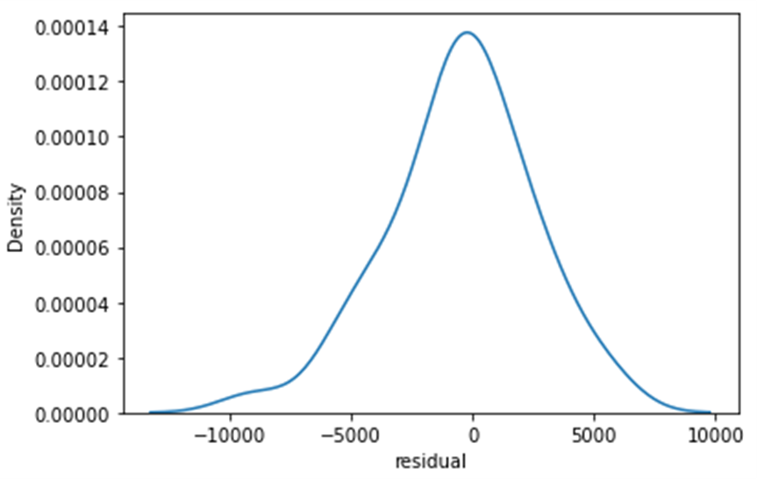
How to plot the distribution of the residuals
sns.kdeplot(data=final, x='residual')

Slide 13
How to create a multiple regression model with two variables
Step 1: Split the data into the training and test datasets
x_train, x_test, y_train, y_test = train_test_split(
carsData[['enginesize','curbweight']],
carsData[['price']], test_size=0.20, random_state=20)
Step 2: Create the model from the training dataset
model = LinearRegression()
model.fit(x_train, y_train)
Step 3: Score the model with the test dataset
model.score(x_test, y_test)
===========================
0.758107274867953
Step 4: Score the model with the training dataset
model.score(x_train, y_train)
=============================
0.7950435284247739

Slide 14
How to use the multiple regression model to make predictions for the test dataset
y_predicted = model.predict(x_test)

Slide 15
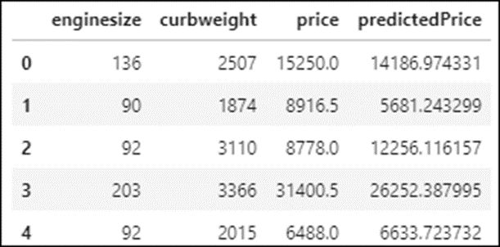
How to create a DataFrame for the predicted and actual prices (multiple regression)
Create the DataFrame for the price predictions
predicted = pd.DataFrame(y_predicted, columns=['predictedPrice'])
Combine the test data and the predicted data into a DataFrame
final = predicted.join([x_test.reset_index(drop=True),
y_test.reset_index(drop=True)])
final.head()[['enginesize','curbweight','price',
'predictedPrice']]

Slide 16
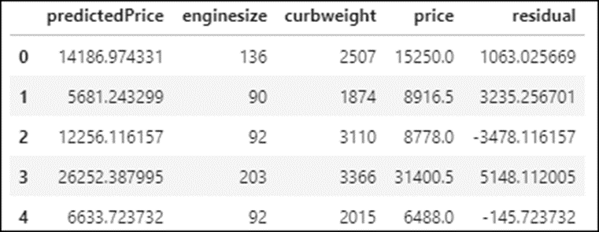
How to calculate the residuals for a multiple regression
final['residual'] = final.price - final.predictedPrice
final.head()

Slide 17
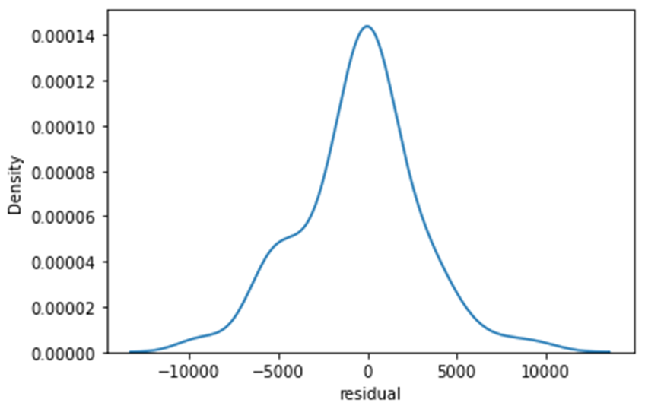
How to plot the residuals
sns.kdeplot(data=final, x='residual')

Slide 18
Types of categorical variables
Type | Description
nominal | Categorical data that can’t be ordered in a meaningful way
ordinal | Categorical data that can be ordered in a meaningful way
dichotomous | Categorical data that can fall into only two categories

Slide 19
How to identify different types of categorical data

Slide 20
How to review the dichotomous variables
carsData.enginelocation.value_counts()
======================================
front 202
rear 3
carsData.fueltype.value_counts()
================================
gas 185
diesel 20
carsData.aspiration.value_counts()
==================================
std 168
turbo 37
carsData.doornumber.value_counts()
==================================
four 115
two 90

Slide 21
How to review the nominal variables (part 1)
carsData.fuelsystem.value_counts()
==================================
mpfi 94
2bbl 66
idi 20
1bbl 11
spdi 9
4bbl 3
spfi 1
mfi 1
carsData.carbody.value_counts()
===============================
sedan 96
hatchback 70
wagon 25
hardtop 8
convertible 6

Slide 22
How to review the nominal variables (part 2)
carsData.drivewheel.value_counts()
==================================
fwd 120
rwd 76
4wd 9
carsData.enginetype.value_counts()
==================================
ohc 148
ohcf 15
ohcv 13
l 12
dohc 12
rotor 4
dohcv 1

Slide 23
How to review the nominal variables (part 3)
carsData.cylindernumber.value_counts()
======================================
four 159
six 24
five 11
eight 5
two 4
three 1
twelve 1

Slide 24
How to create dummy variables for the categorical columns
catColumns = ['aspiration','doornumber','carbody','drivewheel']
dummies = pd.get_dummies(carsData[catColumns])
dummies.info()
===============================================
Data columns (total 12 columns):
# Column Non-Null Count Dtype
--- ------ -------------- -----
0 aspiration_std 205 non-null uint8
1 aspiration_turbo 205 non-null uint8
2 doornumber_four 205 non-null uint8
3 doornumber_two 205 non-null uint8
4 carbody_convertible 205 non-null uint8
5 carbody_hardtop 205 non-null uint8
6 carbody_hatchback 205 non-null uint8
7 carbody_sedan 205 non-null uint8
8 carbody_wagon 205 non-null uint8
9 drivewheel_4wd 205 non-null uint8
10 drivewheel_fwd 205 non-null uint8
11 drivewheel_rwd 205 non-null uint8
dtypes: uint8(12)
memory usage: 2.5 KB

Slide 25
How to combine the numeric data with the dummy variables
carsDummies = carsData.drop(columns=catColumns)
carsDummies = carsDummies.join(dummies)
carsDummies.info()
=================================================
RangeIndex: 205 entries, 0 to 204
Data columns (total 26 columns):
# Column Non-Null Count Dtype
--- ------ -------------- -----
0 car_ID 205 non-null int64
1 symboling 205 non-null int64
2 CarName 205 non-null object
3 fueltype 205 non-null object
4 enginelocation 205 non-null object
5 wheelbase 205 non-null float64
6 carlength 205 non-null float64
...

Slide 26
How to combine the numeric data with the dummy variables (continued)
28 carbody_hatchback 205 non-null uint8
29 carbody_sedan 205 non-null uint8
30 carbody_wagon 205 non-null uint8
31 drivewheel_4wd 205 non-null uint8
32 drivewheel_fwd 205 non-null uint8
33 drivewheel_rwd 205 non-null uint8
dtypes: float64(8), int64(8), object(6), uint8(12)
memory usage: 37.8+ KB

Slide 27
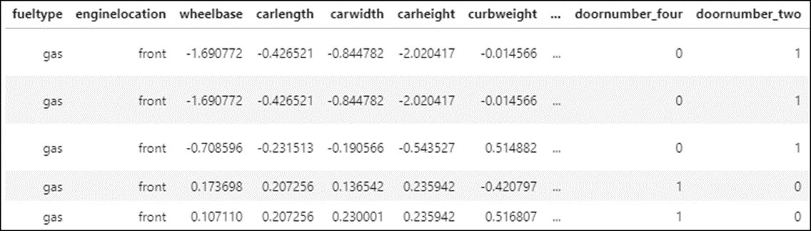
How to rescale the data
from sklearn.preprocessing import StandardScaler
scaler = StandardScaler()
numCols = ['wheelbase','carlength','carwidth','carheight','curbweight',
'enginesize','boreratio','stroke','compressionratio',
'horsepower','peakrpm','citympg','highwaympg']
carsDummies[numCols] = scaler.fit_transform(carsDummies[numCols])
carsDummies.head()

Slide 28
How to check the correlations in the rescaled data
carsDummies.corr()[['price']].sort_values(by='price', ascending=False)
======================================================================
price
-----
price 1.000000
enginesize 0.874145
curbweight 0.835305
horsepower 0.808139
carwidth 0.759325
carlength 0.682920
drivewheel_rwd 0.638957
wheelbase 0.577816
boreratio 0.553173
carbody_hardtop 0.225824
...
aspiration_std -0.177926
carbody_hatchback -0.262039
drivewheel_fwd -0.601950
citympg -0.685751
highwaympg -0.697599

Slide 29
How to create a multiple regression model that includes dummy variables
Step 1: Split the data into the training and test datasets
carsTrain, carsTest = train_test_split(carsDummies, test_size=0.2,
random_state=20)
Step 2: Create the multiple regression model
model = LinearRegression()
xCols = ['enginesize','horsepower','carwidth',
'drivewheel_rwd','highwaympg']
model.fit(carsTrain[xCols], carsTrain['price'])
Step 3: Score the model with the test dataset
model.score(carsTest[xCols], carsTest['price'])
===============================================
0.6910912856235985
Step 4: Score the model with the training dataset
model.score(carsTrain[xCols], carsTrain['price'])
=================================================
0.8507491647131596

Slide 30
Use the model to make predictions
y_predicted = model.predict(carsTest[xCols])

Slide 31
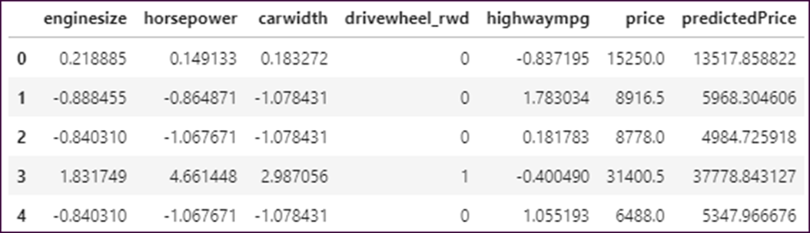
Create a DataFrame for the predicted and actual prices
predicted = pd.DataFrame(y_predicted, columns=['predictedPrice'])
final = predicted.join([carsTest[xCols].reset_index(drop=True),
carsTest['price'].reset_index(drop=True)])
final[['enginesize','horsepower','carwidth','drivewheel_rwd',
'highwaympg','price','predictedPrice']].head()

Slide 32
Code that creates a heatmap for the independent variables
sns.heatmap(
carsTrain.corr()[['enginesize','curbweight','horsepower',
'carwidth',drivewheel_rwd','highwaympg','citympg','boreratio',
'price']].sort_values(by='price', ascending=False),
cmap='Blues', annot=True)

Slide 33
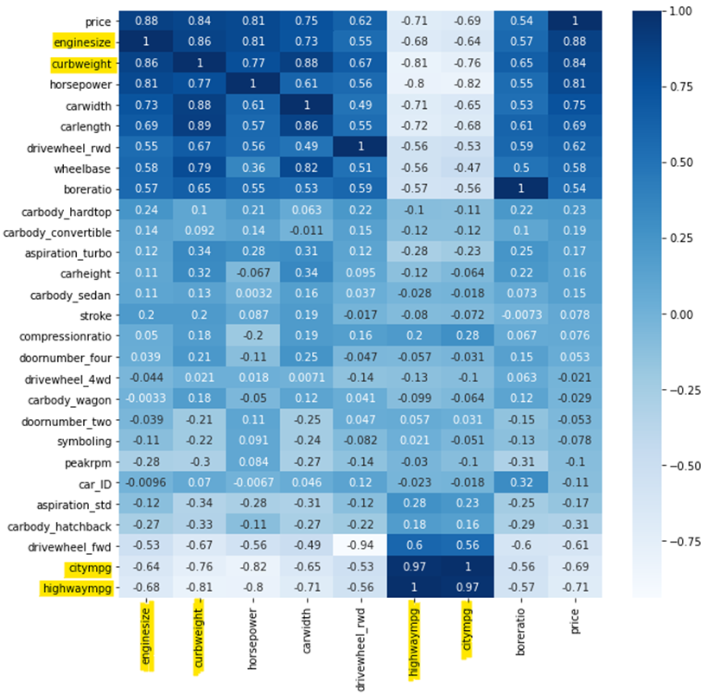
A heatmap for the independent variables

Slide 34
An initial model that’s fitted to eight independent variables
model = LinearRegression()
xCols = ['enginesize','curbweight','horsepower','carwidth',
'carlength','drivewheel_rwd','highwaympg','citympg']
model.fit(carsTrain[xCols], carsTrain['price'])
model.score(carsTest[xCols], carsTest['price'])
===========================================================
0.684810264257876
model.score(carsTrain[xCols], carsTrain['price'])
===========================================================
0.851624608739667

Slide 35
The initial model without the citympg column
model = LinearRegression()
xCols = ['enginesize','curbweight','horsepower','carwidth',
'carlength','drivewheel_rwd','highwaympg']
model.fit(carsTrain[xCols], carsTrain['price'])
model.score(carsTest[xCols], carsTest['price'])
===========================================================
0.6892190640435765
model.score(carsTrain[xCols], carsTrain['price'])
===========================================================
0.851100492829518

Slide 36
A model that’s fitted to all the numeric and dummy variables
model = LinearRegression()
xCols = carsTrain.corr().drop(columns=['price']).columns.tolist()
model.fit(carsTrain[xCols], carsTrain['price'])
model.score(carsTest[xCols], carsTest['price'])
=================================================================
0.7668904310536844
model.score(carsTrain[xCols], carsTrain['price'])
=================================================================
0.9031423149672445

Slide 37
The SelectKBest() method
Method | Description
SelectKBest(params) | Selects the top k features based on the values returned by the scoring function. Returns a feature selection object that has fit() and transform() methods.
Parameters of the SelectKBest() method
Parameter | Description
score_func | The scoring function that selects the variables.
k | The number of independent variables to use. Use ‘all’ for all variables.

Slide 38
How to select the right features
Import the SelectKBest() method and the mutual_info_regression function
from sklearn.feature_selection import SelectKBest
from sklearn.feature_selection import mutual_info_regression
Step 1: Split the data and drop non-numeric columns
carsTrain, carsTest = train_test_split(carsDummies.drop( columns=['CarName','fueltype','enginelocation',
'cylindernumber','fuelsystem','enginetype']),
test_size=0.2, random_state=20)
Step 2: Create the feature selector and fit the data to it
fs = SelectKBest(score_func=mutual_info_regression, k=20)
fs.fit(carsTrain.drop(columns=['price']), carsTrain['price'])
Step 3: Transform the training and test data
x_train_fs = fs.transform(carsTrain.drop(columns=['price']))
x_test_fs = fs.transform(carsTest.drop(columns=['price']))

Slide 39
How to select the right features (continued)
Step 4: Use the transformed data in the regression
model = LinearRegression()
model.fit(x_train_fs, carsTrain['price'])
model.score(x_test_fs, carsTest['price'])
=========================================
0.7672356288280073
model.score(x_train_fs, carsTrain['price'])
===========================================
0.8916022232056895

Slide 40
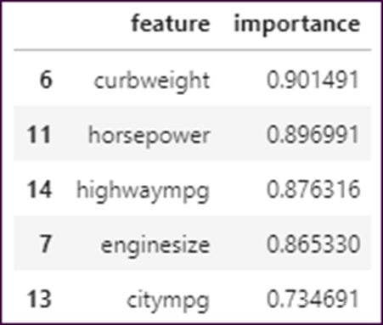
How to display the importance of each feature
df1 = pd.DataFrame(carsTrain.drop(columns=['price']).columns,
columns=['feature'])
df2 = pd.DataFrame(fs.scores_, columns=['importance'])
importance = df1.join(df2)
importance.sort_values('importance', ascending=False).head()

Slide 41
How use a for loop to score the model for varying numbers of features
model = LinearRegression()
testScores = []
trainScores = []
for i in range(1, len(carsTrain.columns)):
fs = SelectKBest(score_func=mutual_info_regression, k=i)
fs.fit(carsTrain.drop(columns=['price']), carsTrain['price'])
x_train_fs = fs.transform(carsTrain.drop(columns=['price']))
x_test_fs = fs.transform(carsTest.drop(columns=['price']))
model.fit(x_train_fs, carsTrain['price'])
testScore = model.score(x_test_fs, carsTest['price'])
trainScore = model.score(x_train_fs, carsTrain['price'])
testScores.append(testScore)
trainScores.append(trainScore)

Slide 42
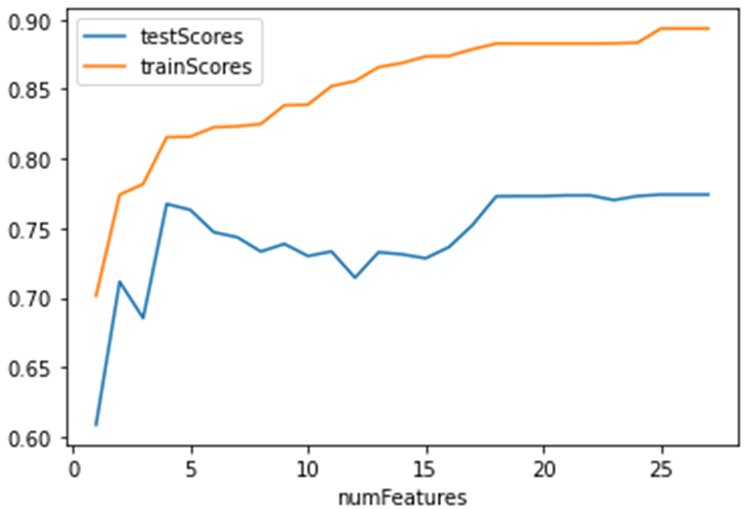
How to plot the test and training scores
df = pd.DataFrame(data={'testScores':testScores,
'trainScores':trainScores})
df.reset_index(inplace=True)
df.rename(columns={'index':'numFeatures'}, inplace=True)
df.numFeatures = df.numFeatures + 1
df.plot(x='numFeatures', y=['testScores','trainScores'])

